Slide 1
Chapter 3
The Relational Database Model
Database Systems:
Design, Implementation, and Management / 6e Rob and Coronel

Slide 2
In this chapter, you will learn:
That the relational database model takes a logical view of data
That the relational model’s basic components are entities, attributes, and relationships among entities
How entities and their attributes are organized into tables

Slide 3
In this chapter, you will learn:
About relational database operators, the data dictionary, and the system catalog
How data redundancy is handled in the relational database model
Why indexing is important

Slide 4
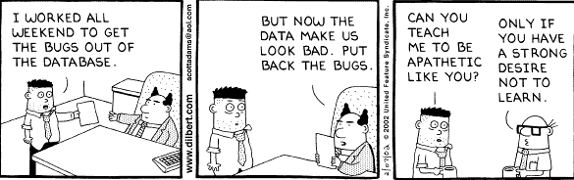

Slide 5
A Logical View of Data
Relational model
  Enables us to view data logically rather than physically
  Reminds us of simpler file concept of data storage
Table
  Has advantages of structural and data independence
  Resembles a file from conceptual point of view
  Easier to understand than its hierarchical and network database predecessors

Slide 6
Tables and Their Characteristics
Table: two-dimensional structure composed of rows and columns
Contains group of related entities→ an entity set
  Terms entity set and table are often used interchangeably

Slide 7
Tables and Their Characteristics
Table also called a relation because the relational model’s creator, Codd, used the term relation as a synonym for table
Think of a table as a persistent relation:
  A relation whose contents can be permanently saved for future use

Slide 8
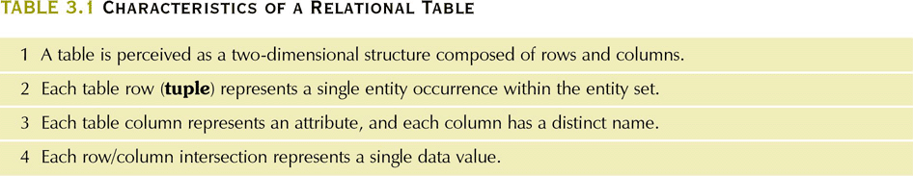
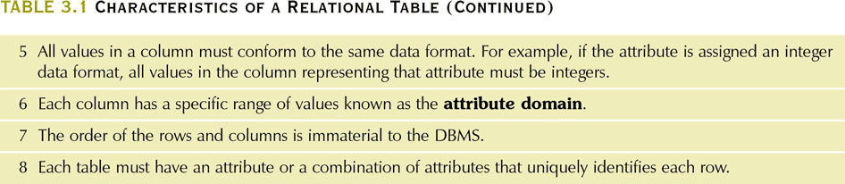
Characteristics of a Relational Table
Table 3.1

Slide 9
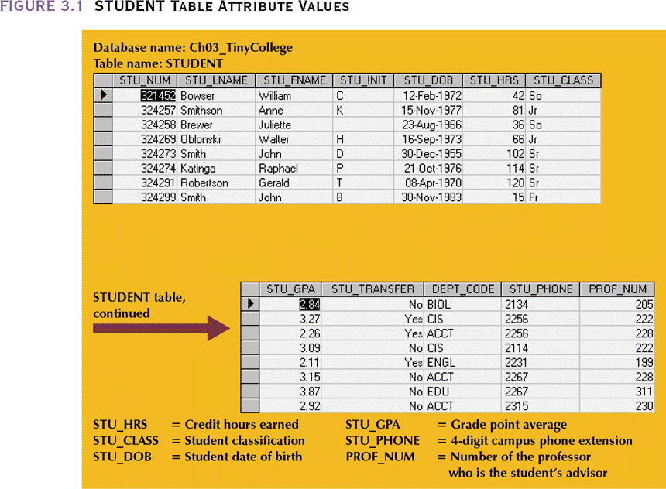
STUDENT Table Attribute Values

Slide 10
Keys
Consists of one or more attributes that determine other attributes
Primary key (PK) is an attribute (or a combination of attributes) that uniquely identifies any given entity (row)
Key’s role is based on determination
  If you know the value of attribute A, you can look up (determine) the value of attribute B. This is written as A→B (A determines B)

Slide 11
Determination
Knowing STU_NUM in the STUDENT table means you are able to look up (determine) the student’s last name, GPA, phone number, etc.
  STU_NUM→STU_LNAME
  STU_NUM→STU_LNAME, STU_FNAME, STU_INIT,STU_DOB,STU_TRANSFER
STU_NUM is not determined by STU_LNAME because more than one student can have the same last name

Slide 12
Determination
The principle of determination is very important as it is used in the definition of a central relational database concept known as functional dependence
  The attribute B is functionally dependent on A…
    if A determines B, or equivalently
    if each value in column A determines one and only one value in column B
      STU_PHONE is f.d. on STU_NUM but, since there are two students with the same phone number, STU_NUM is not f.d. on STU_PHONE
      The same is true for STU_LNAME – there are two students named Smith

Slide 13
Determination
To generalize – Attribute A determines attribute B (that is, B is f.d. on A) if all the rows in the table that agree in value for attribute A must also agree in value for attrribute B
  Just because a sample of the database doesn’t show duplication (such as duplicate last names for different student number) that does not mean it can not occur. The business rules regarding the table need to be known i.e., what is allowed and what is not allowed.

Slide 14
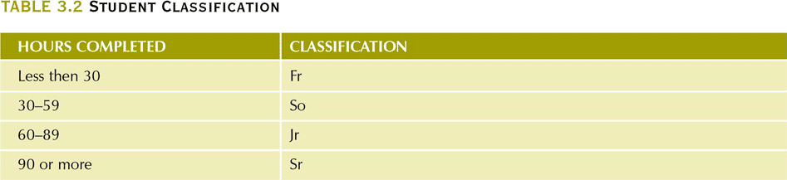
Student Classification
We can write STU_HRS→STU_CLASS
We can not write STU_CLASS→STU_HRS as a junior can have any number of hours between 60 through 89.
  STU_CLASS does not determine one and only one value for STU_HRS

Slide 15
Keys
Composite key
  Composed of more than one attribute
Key attribute
  Any attribute that is part of a key
  STU_LNAME is not sufficient to serve as a key but WE CAN WRITE
    STU_LNAME,STU_FNAME,STU_INIT,STU_PHONE→STU_HRS,STU_CLASS or
    STU_LNAME,STU_FNAME,STU_INIT,STU_PHONE→STU_HRS,STU_CLASS,STU_GPA or
    STU_LNAME,STU_FNAME,STU_INIT,STU_PHONE→STU_HRS,STU_CLASS,STU_GPA,STU_DOB

Slide 16
Keys
Full Functional Dependence
  The attribute (B) is f.f.d. on (A) if the attribute (B) is f.d. on a composite key (A) but not on any subset of that composite key
Superkey
  Any key that uniquely identifies each entity
    STU_NUM or STU_NUM,STU_LNAME or STU_NUM,STU_LNAME,STU_INIT
Candidate key
  A superkey without redundancies

Slide 17
Keys
Candidate key
  A superkey without redundancies
  STU_NUM,STU_LNAME is a superkey but not a candidate key because STU_NUM by itself is a candidate key
  STU_LNAME,STU_FNAME,STU_INIT, STU_PHONE might also be a candidate key as long as two students can not have the same last name, first name, initial and phone number
  If social security number would be an attribute, but it and student number would be candidates keys

Slide 18
Null Values
No data entry (zero or space values are not null)
Not permitted in primary key to ensure entity integrity
Should be avoided in other attributes
Can represent
  An unknown attribute value
  A known, but missing, attribute value
  A “not applicable” condition
Can create problems in logic and using formulas (e.g., computing averages)

Slide 19
Controlled Redundancy
Makes the relational database work
Tables within the database share common attributes that enable us to link tables together
Multiple occurrences of values in a table are not redundant when they are required to make the relationship work
Redundancy is unnecessary duplication of data

Slide 20
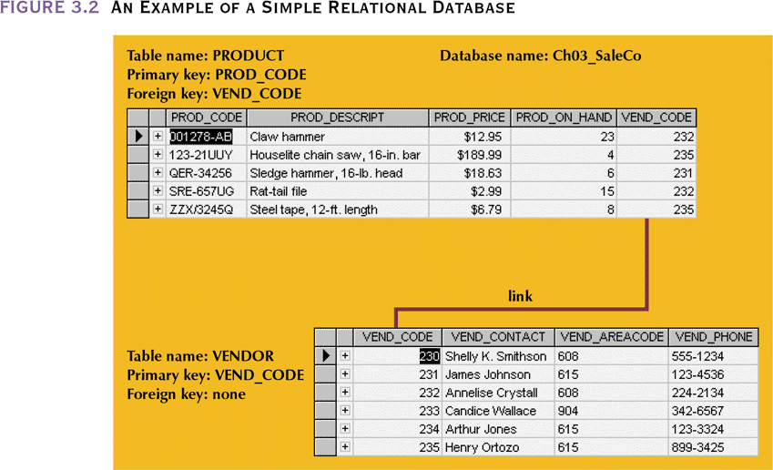
An Example of a
Simple Relational Database

Slide 21
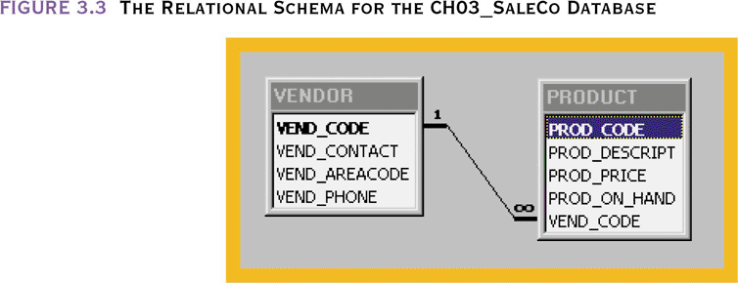
The Relational Schema for the CH03_SaleCo Database

Slide 22
Keys (continued)
Foreign key (FK)
  An attribute whose values match primary key values in the related table
Referential integrity
  FK contains a value that refers to an existing valid tuple (row) in another relation
Secondary key
  Key used strictly for data retrieval purposes
    Customer may not remember their assigned customer number but will know their name and phone number.
    These last two fields can be used together as a secondary key (need not be unique but helps to narrow the search)
    Customer city can be a secondary key but may return so many rows as to be unhelpful

Slide 23
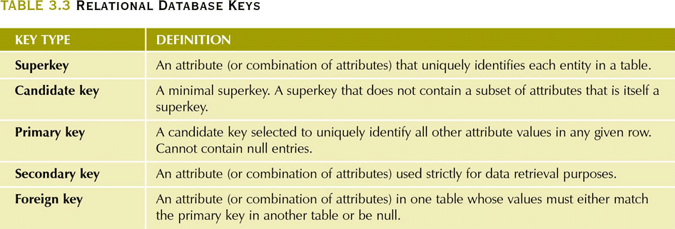
Relational Database Keys

Slide 24
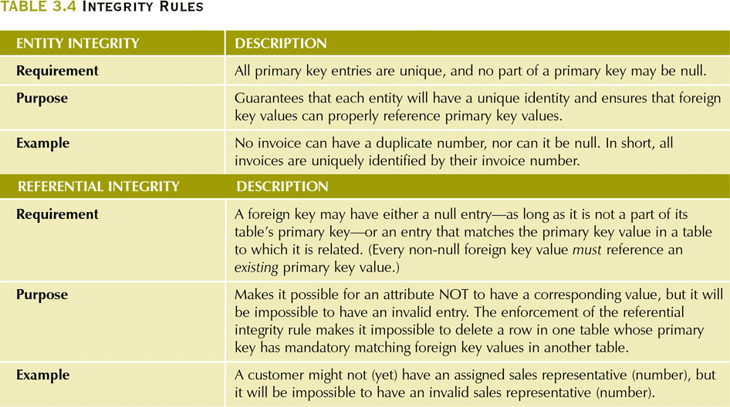
Integrity Rules

Slide 25
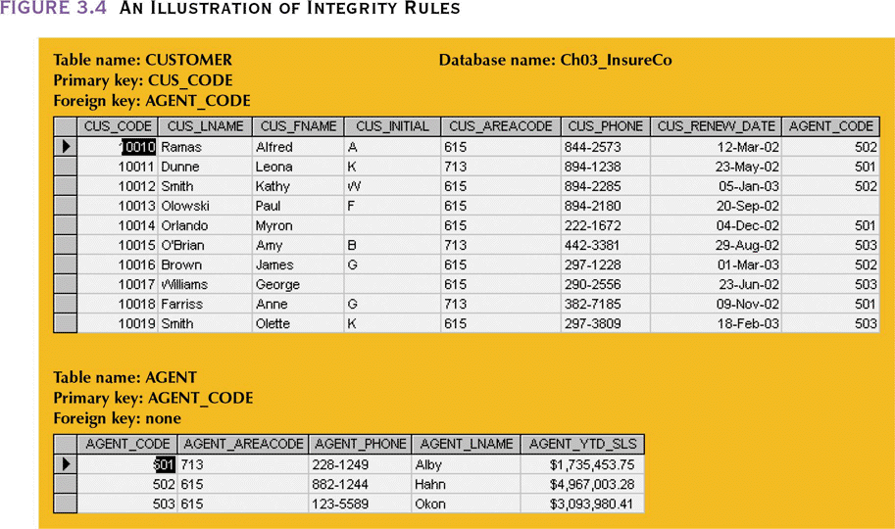
An Illustration of Integrity Rules
Entity integrity – PK of CUSTOMER and AGENT tables are unique and have no null entries
Referential integrity – CUSTOMER table has a FK which links it to the AGENT table. One customer (10013) has a null value for AGENT_CODE (not the table’s PK) as an agent has not been assigned to him. All other FKs agent codes found in AGENT.

Slide 26

A Dummy Variable Value Used as a Flag
To avoid nulls in FKs, some designers use a flag to indicate the absence of some value.
Code -99 could be used as the agent code for that purpose which means the AGENT table would have a record as appears below

Slide 27
Relational Database Operators
Relational algebra
  Defines theoretical way of manipulating table contents using relational operators:
    SELECT ◻ UNION
    PROJECT ◻ DIFFERENCE
    JOIN ◻ PRODUCT
    INTERSECT ◻ DIVIDE
  Use of relational algebra operators on existing tables (relations) produces new relations

Slide 28
Relational Algebra Operators
Union:
  Combines all rows from two tables, excluding duplicate rows
  Tables must have the same attribute characteristics
Intersect:
  Yields only the rows that appear in both tables

Slide 29
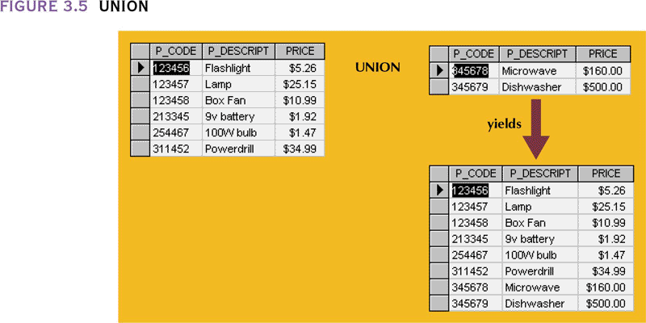
Union

Slide 30
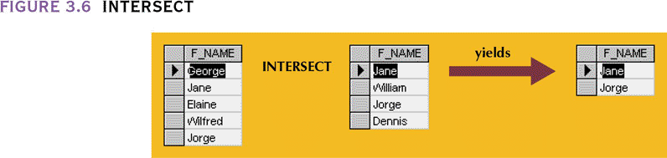
Intersect

Slide 31
Relational Algebra Operators
Difference
  Yields all rows in one table not found in the other table—that is, it subtracts one table from the other
Product
  Yields all possible pairs of rows from two tables
    Also known as the Cartesian product

Slide 32
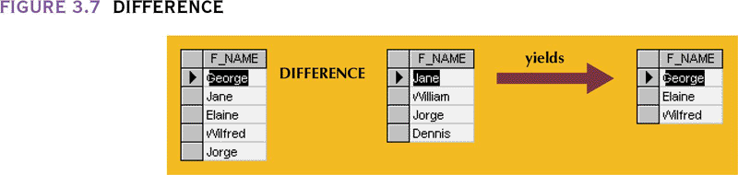
Difference

Slide 33
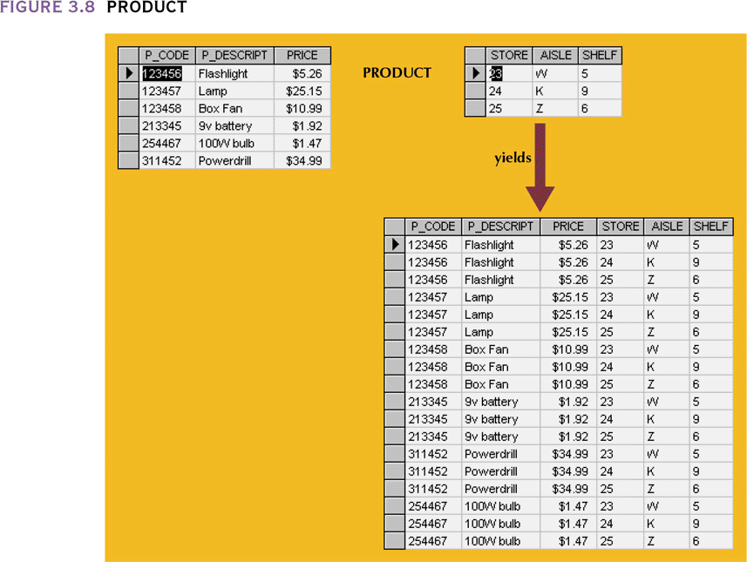
Product

Slide 34
Relational Algebra Operators
Select
  Yields values for all rows found in a table
  Can be used to list either all row values or it can yield only those row values that match a specified criterion
  Yields a horizontal subset of a table
Project
  Yields all values for selected attributes
  Yields a vertical subset of a table

Slide 35
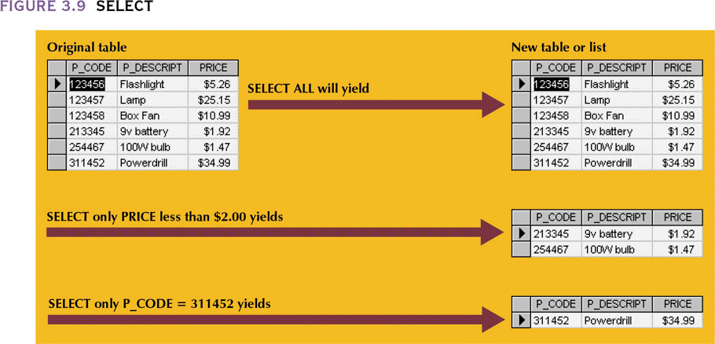
Select

Slide 36
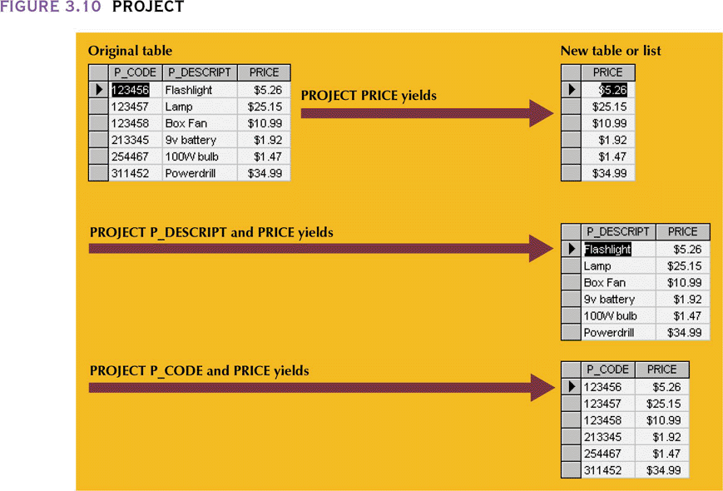
Project

Slide 37
Relational Algebra Operators
Join
  Allows us to combine information from two or more tables
  Real power behind the relational database, allowing the use of independent tables linked by common attributes

Slide 38
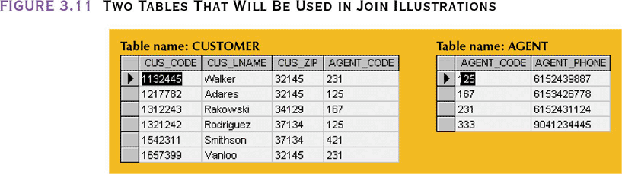
Two Tables That Will Be Used in Join Illustrations

Slide 39
Natural Join
Links tables by selecting only rows with common values in their common attribute(s)
Result of a three-stage process:
  PRODUCT of the tables is created
  SELECT is performed on Step 1 output to yield only the rows for which the AGENT_CODE values are equal
    Common column(s) are called join column(s)
  PROJECT is performed on Step 2 results to yield a single copy of each attribute, thereby eliminating duplicate columns

Slide 40
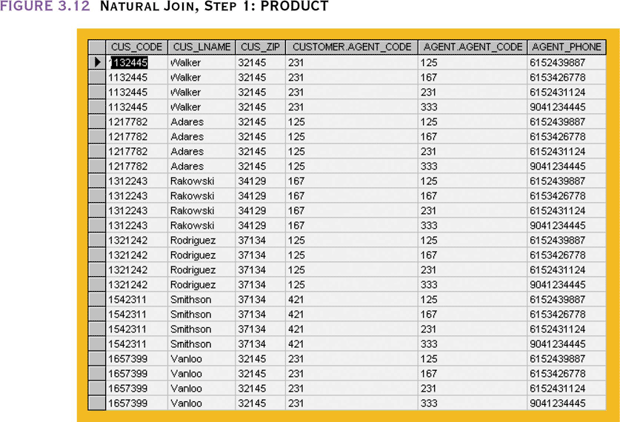
Natural Join, Step 1: PRODUCT

Slide 41
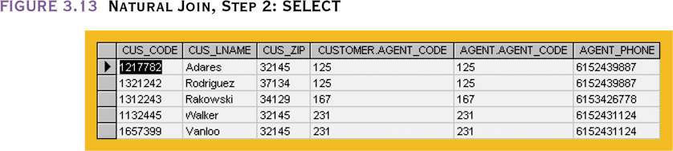
Natural Join, Step 2: SELECT

Slide 42
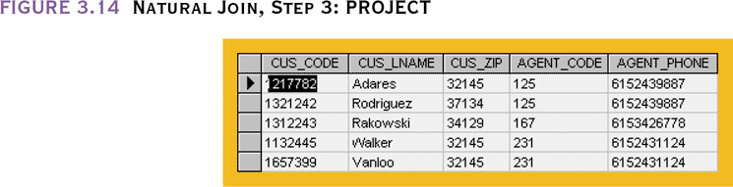
Natural Join, Step 3: PROJECT

Slide 43
Natural Join
Final outcome yields table that
  Does not include unmatched pairs
  Provides only copies of matches
If no match is made between the table rows,
  the new table does not include the unmatched row

Slide 44
Natural Join
The column on which we made the JOIN—that is, AGENT_CODE—occurs only once in the new table
If the same AGENT_CODE were to occur several times in the AGENT table,
  a customer would be listed for each match

Slide 45
Other Forms of Join
Equijoin
  Links tables on the basis of an equality condition that compares specified columns of each table
  Outcome does not eliminate duplicate columns
  Condition or criterion to join tables must be explicitly defined
  Takes its name from the equality comparison operator (=) used in the condition
Theta join
  If any other comparison operator is used

Slide 46
Outer Join
Matched pairs are retained and any unmatched values in other table are left null
  Extremely useful in determining referential integrity between tables (unmatched foreign keys)
In outer join for tables CUSTOMER and AGENT, two scenarios are possible:
  Left outer join
    Yields all rows in CUSTOMER table, including those that do not have a matching value in the AGENT table
  Right outer join
    Yields all rows in AGENT table, including those that do not have matching values in the CUSTOMER table

Slide 47
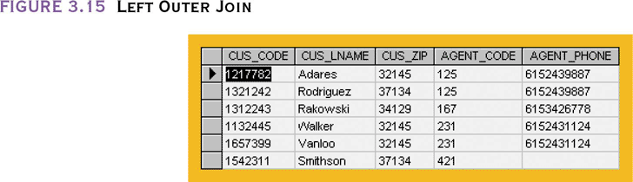
Left Outer Join

Slide 48
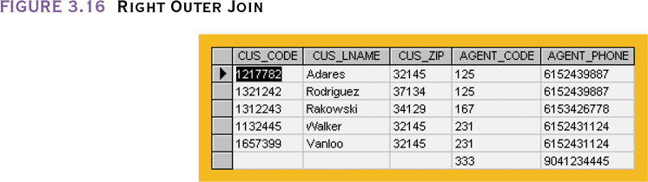
Right Outer Join

Slide 49
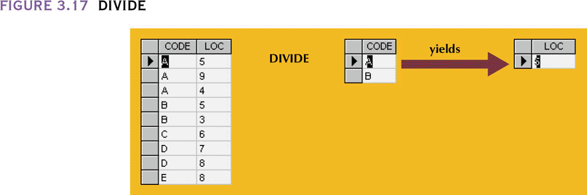
Divide
DIVIDE requires the use of one single-column table and one two-column table
  To be included in the result table, a value in the unshared column (LOC) must be associated with all values in Table 2 (A,B) found in Table 1 (A-5,9,4 and B-5,3)

Slide 50
The Data Dictionary and System Catalog
Data dictionary
  Used to provide detailed accounting of all tables found within the user/designer-created database
  Contains (at least) all the attribute names and characteristics for each table in the system
  Contains metadata—data about data
  Sometimes described as “the database designer’s database” because it records the design decisions about tables and their structures

Slide 51
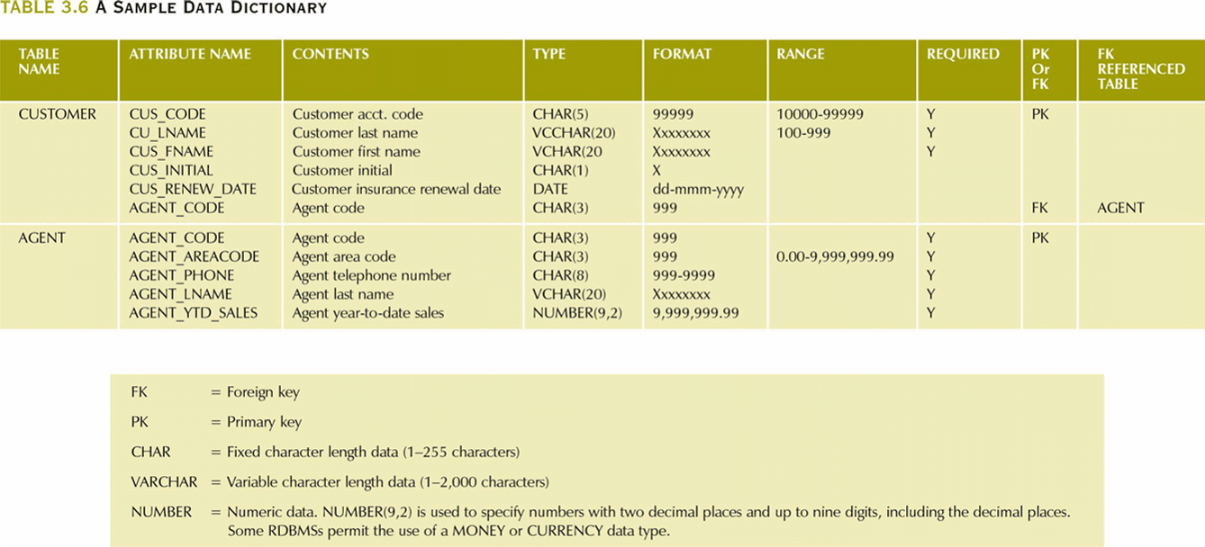
A Sample Data Dictionary

Slide 52
The Data Dictionary and System Catalog
System catalog
  Contains metadata
  Detailed system data dictionary that describes all objects within the database
    Table names, creator, creation date, number of columns, data type per column, index filenames, index creators, authorized users, access privileges, etc.
  Terms “system catalog” and “data dictionary” are often used interchangeably
  Can be queried just like any user/designer-created table

Slide 53
Relationships within the Relational Database
1:M relationship
  Relational modeling ideal
  Should be the norm in any relational database design
M:N relationships
  Must be avoided because they lead to data redundancies
1:1 relationship
  Should be rare in any relational database design

Slide 54
The 1:1 Relationship
One entity can be related to only one other entity, and vice versa
Often means that entity components were not defined properly
Could indicate that two entities actually belong in the same table
Sometimes 1:1 relationships are appropriate
  ACCOUNT table with three types of specialized accounts – CHECKING, IRA, SAVINGS
  All three have common attributes but each of the three has unique attributes not in common with the others and thus needs a 1:1 link to ACCOUNT

Slide 55
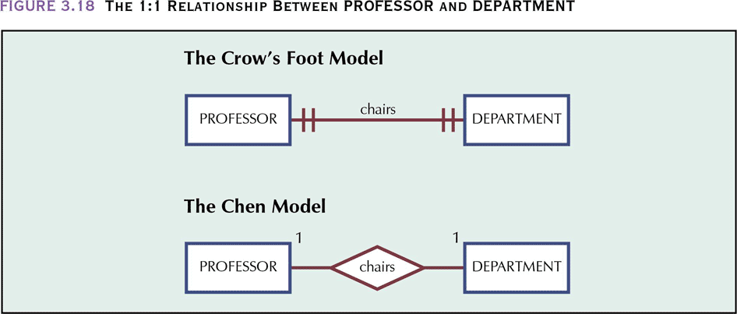
The 1:1 Relationship Between
PROFESSOR and DEPARTMENT

Slide 56
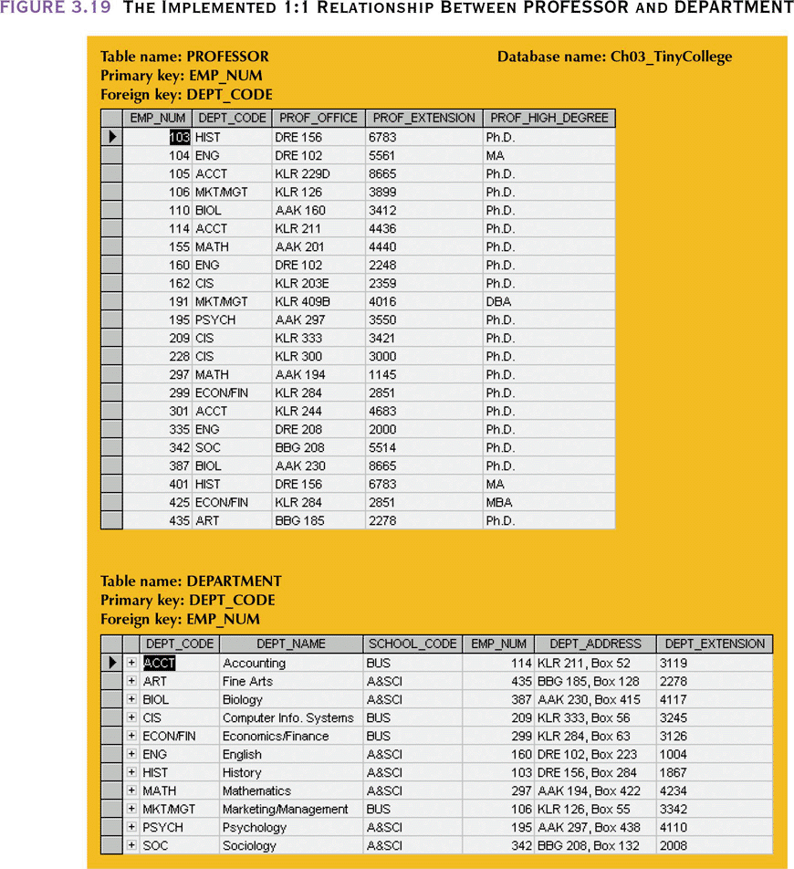
The Implemented 1:1 Relationship Between PROFESSOR and DEPARTMENT

Slide 57
The 1:M Relationship
Relational database norm
Found in any database environment
The primary key of the “1” table is included as the foreign key of the “M” table

Slide 58
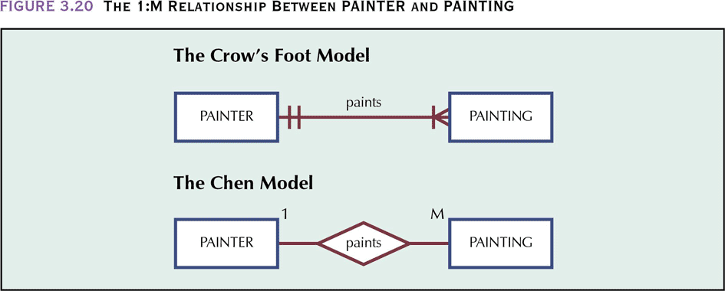
The 1:M Relationship
Between PAINTER and PAINTING

Slide 59
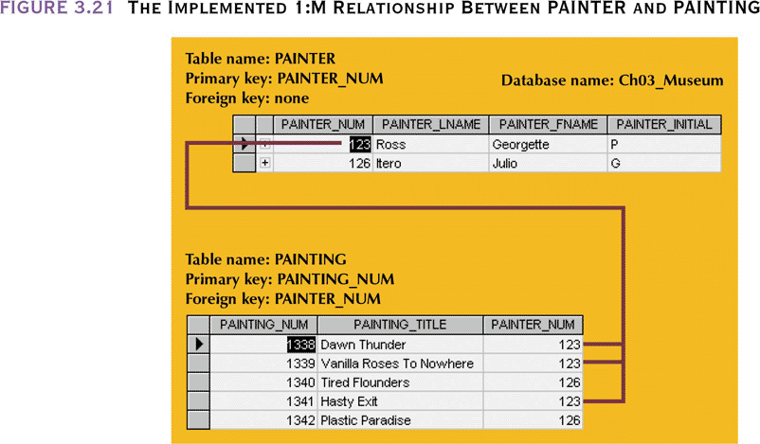
The Implemented 1:M Relationship Between PAINTER and PAINTING

Slide 60
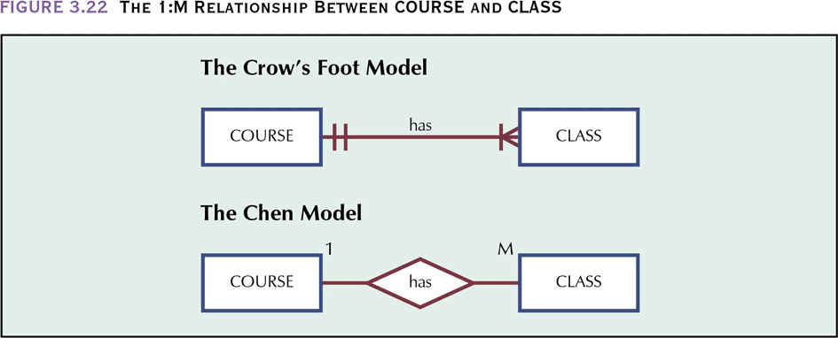
The 1:M Relationship
Between COURSE and CLASS

Slide 61
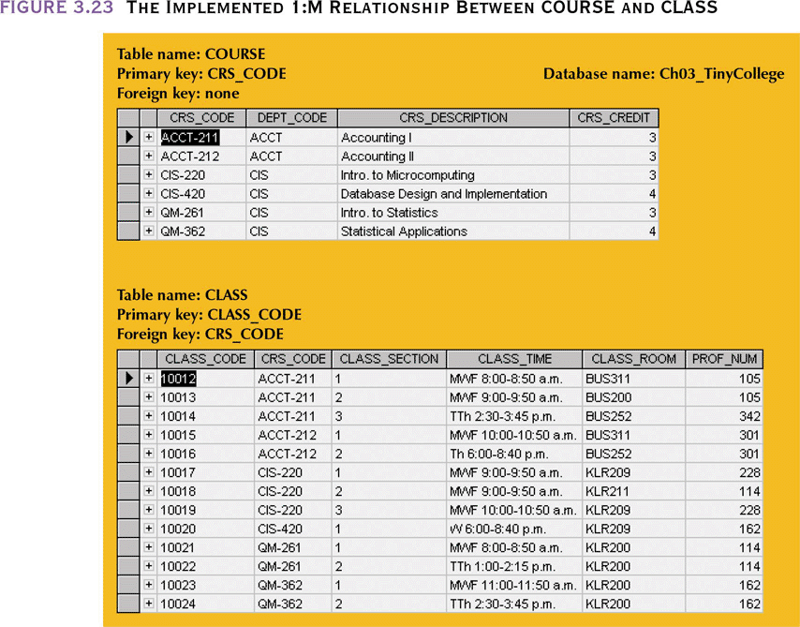
The Implemented 1:M Relationship
Between COURSE and CLASS
In the CLASS table, CRS_CODE+CLASS_SECTION also uniquely identifies each row, making this composite key a candidate key

Slide 62
The M:N Relationship
Can be implemented by breaking it up to produce a set of 1:M relationships
Can avoid problems inherent to M:N relationship by creating a composite entity or bridge entity

Slide 63
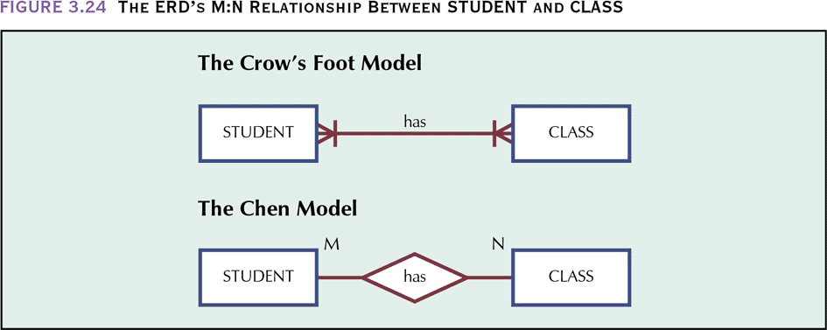
The ERD’s M:N Relationship
Between STUDENT and CLASS
A student has classes in his schedule and a class has many students enrolled

Slide 64
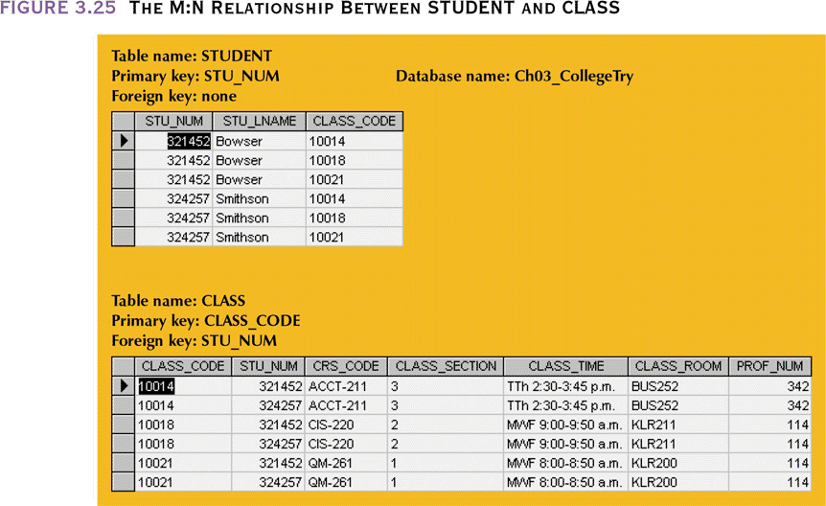
The M:N Relationship
Between STUDENT and CLASS
There are numerous redundancies: STU_NUM values occur many times in the STUDENT table and many duplications are found in CLASS

Slide 65
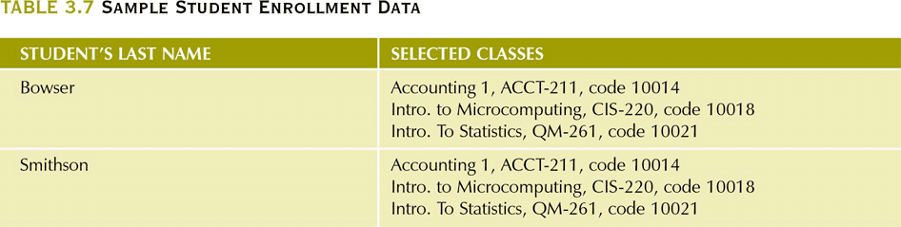
Sample Student Enrollment Data

Slide 66
Linking Table
Implementation of a composite or bridge entity avoids the problems in the M:N relationship
Yields required M:N to 1:M conversion
Composite entity table must contain at least the primary keys of original tables
Linking table contains multiple occurrences of the foreign key values
Additional attributes may be assigned as needed

Slide 67
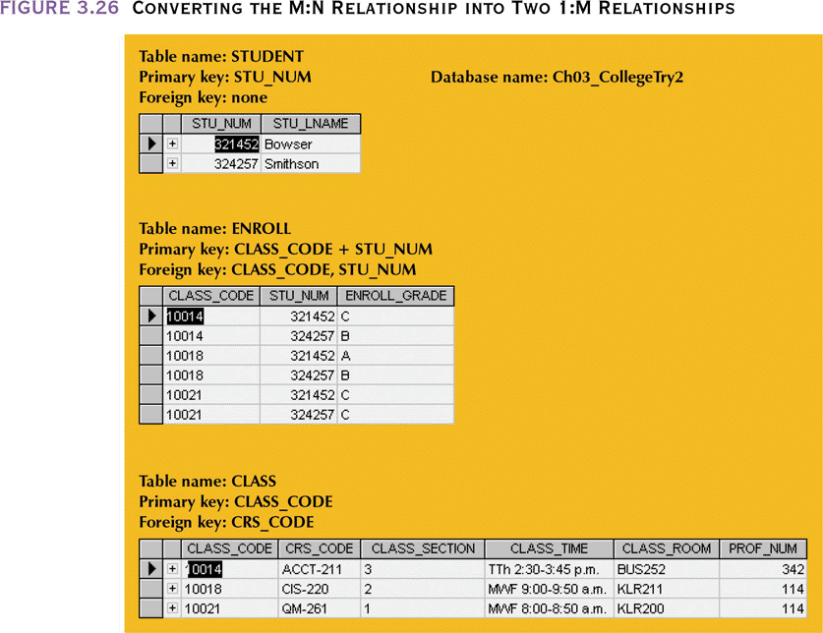
Converting the M:N Relationship into Two 1:M Relationships

Slide 68
Linking Table
The linking table primary key consists of the two attributes CLASS_CODE and STU_NUM to make it unique
The foreign keys repeat throughout the table, but they will not produce anomalies as long as referential integrity is enforced
In the Chen model, the linking table uses a diamond within a rectangle to indicate the existence of a composite entity.

Slide 69
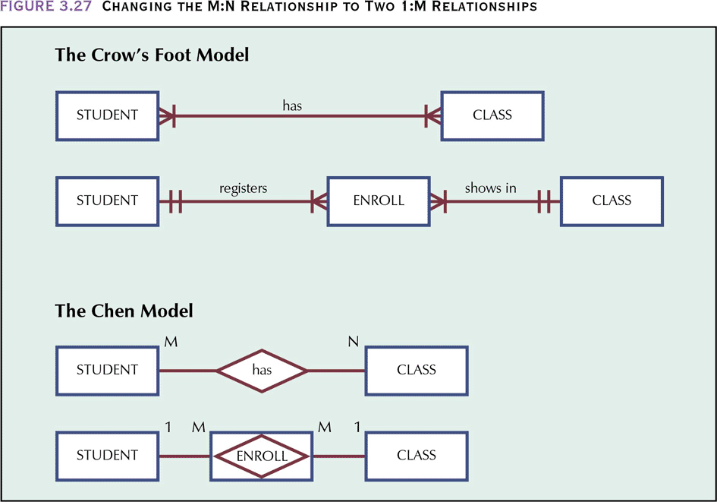
Changing the M:N Relationship to Two 1:M Relationships

Slide 70
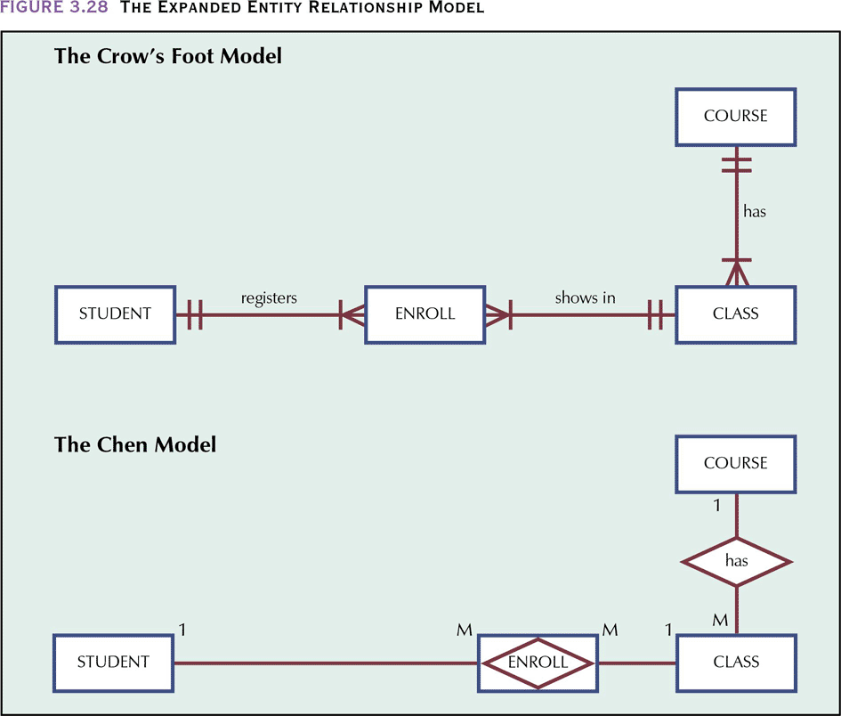
The Expanded Entity Relationship Model

Slide 71
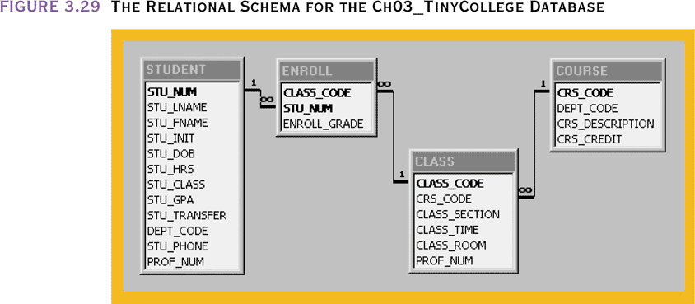
The Relational Schema for the Ch03_TinyCollege Database

Slide 72
Data Redundancy Revisited
Data redundancy leads to data anomalies
  Such anomalies can destroy database effectiveness
Foreign keys
  Control data redundancies by using common attributes shared by tables
  Crucial to exercising data redundancy control
Sometimes, data redundancy is necessary

Slide 73
Data Redundancy Revisited
Database designers must reconcile three often contradictory requirements: design elegance, processing speed and information requirements
The test of redundancy is not how many copies of a given attribute are stored, but whether or not the elimination of an attribute will eliminate information
If you delete an attribute and the original information can still be generated through relational algebra, the inclusion of that attribute would be redundant

Slide 74
A Small Invoicing System
In this system, PROD_PRICE appears in the LINE table even though it is in the PRODUCT table
This is to provide the ability to change the price in the PRODUCT table without impacting old invoices with different prices for the same item
Why is the PK in LINE the composite key INV_NUMBER+LINE_NUMBER instead of INV_NUMBER+PROD_CODE?
  This enables the invoice to display the items in the order they were entered instead of having them sorted by PROD_CODE

Slide 75
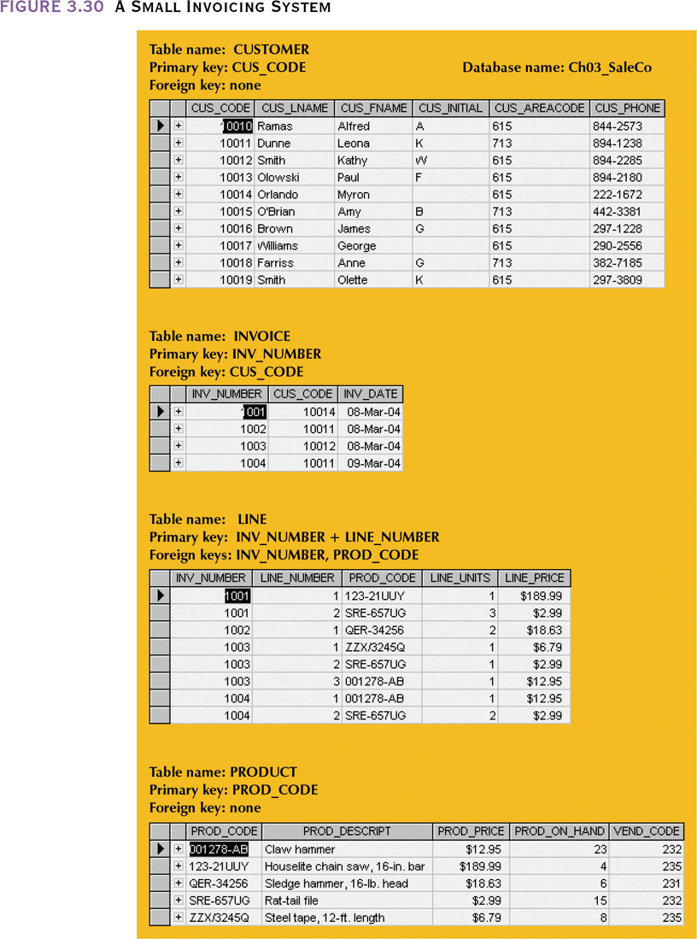
A Small Invoicing System

Slide 76
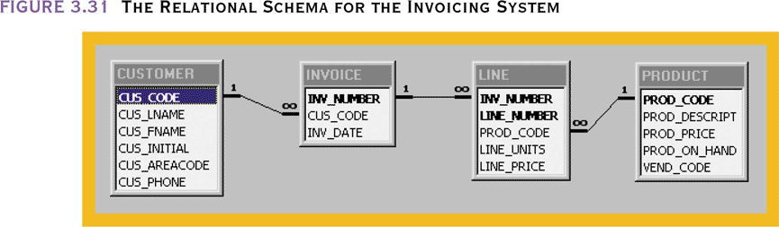
The Relational Schema for the Invoicing System

Slide 77
Indexes
Orderly arrangement used to logically access rows in a table
  Ordered arrangement of keys and pointers
Index key
  Index’s reference point
  Points to data location identified by the key
Unique index
  Index in which the index key can only have one pointer value (row) associated with it
Each index is associated with only one table

Slide 78
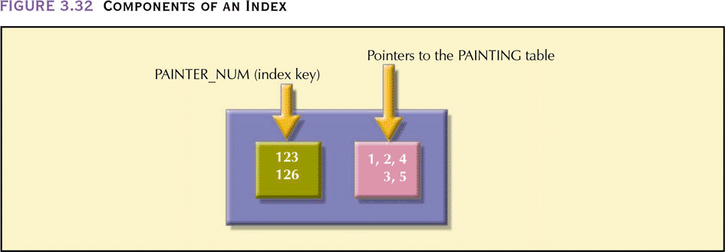
Components of an Index
To look up all the paintings of a specific painter we could read each row in the PAINTING table and see if PAINTER_NUM matched the one we are looking for
Or, we can index the PAINTER_NUM attribute of the PAINTING table and that points us to the records for that painter

Slide 79
Summary
Entities are basic building blocks of a relational database
Entity set is a grouping of related entities, stored in a table
Keys define functional dependencies
  Superkey
  Candidate key
  Primary key
  Secondary key
  Foreign key

Slide 80
Summary (continued)
Primary key uniquely identifies attributes
  Can link tables by using controlled redundancy
Relational databases classified according to degree to which they support relational algebra functions
Relationships between entities are represented by entity relationship models
Data retrieval speed can be increased dramatically by using indexes

